Slide 1

Monte Carlo Simulations
Gayan Dilantha Illeperuma
Dept of Physics
Open University of Sri Lanka

Slide 2

An introduction to Monte -Carlo
Its name originated from the famous Monte-Carlo casino!
Monte-Carlo is a method to …..

Slide 3
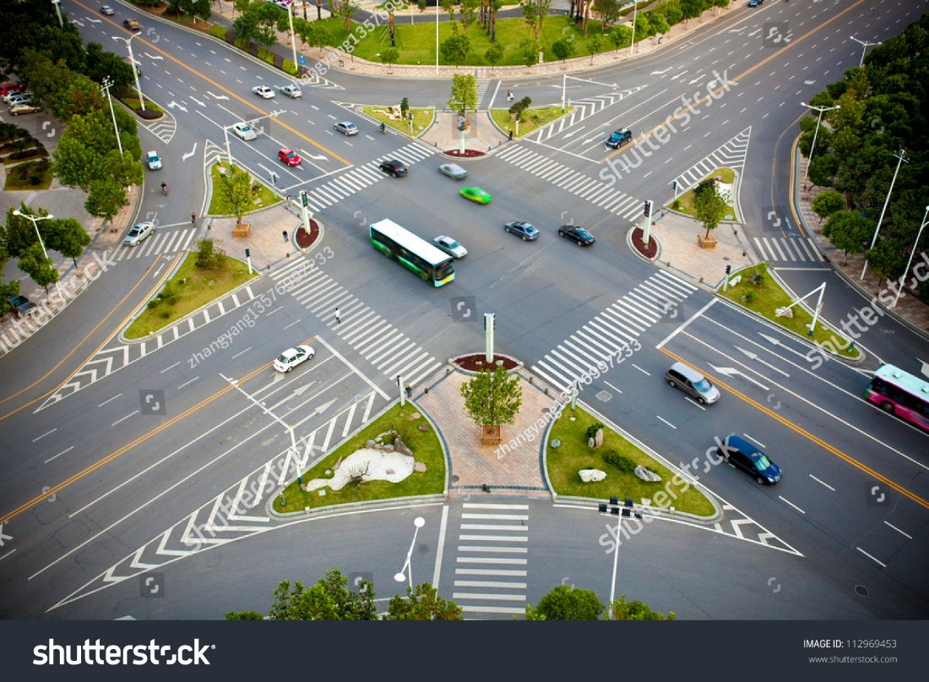
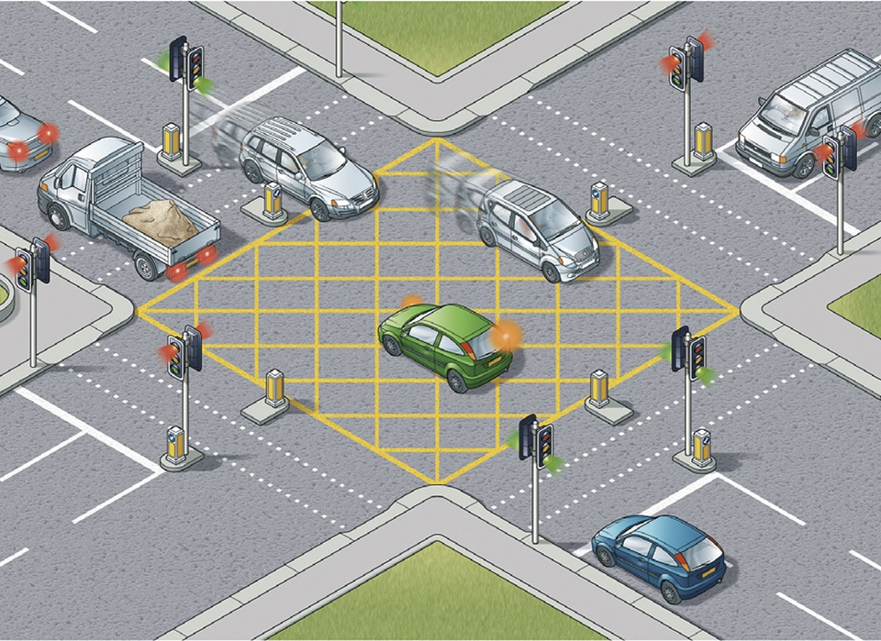

Slide 4
Generate random numbers in python
Import random library , Or you can use scipy or numpy
random( ) : A floating point, 0<= x <=1
uniform(2.5,10.0): floating point, 2.5<= x <=10
randrange(10) : Integers 0-9 inclusive
randrange(0,101,2) : random even integers from 0 to 100

Slide 5
Random distributions
normal(size = 10)
normal (mean, std , num_of_rand_numbers)
Poison(lamda, num_of_rand_numbers)

Slide 6
Pseudo Random Numbers
A random number should not be predictable.
But a computer program follows exact well known set of instructions.
A ‘random’ number generated purely by an algorithm only ‘looks’ random.
If we know the variables we can predict the next value.
They are known as pseudo random number generators

Slide 7
Seed
Psuedo random number generators use a ‘seed’ as starting point to calculate a random number
They can be something like ‘amount of mouse movemet, cpu load…etc
We can supply our own seed to repeat the same random number sequence again and again.
Random.seed(2345)
This is useful in debugging

Slide 8
TRNG
True random number generators use special hardware to generate random numbers (EM noise)
They cannot be predicted or repeated

Slide 9
General steps of a MC simulation
Define a domain of possible states.
Generate states randomly from the domain.
Perform a deterministic computation using the inputs.
Aggregate the results of the individual computations into the final result.

Slide 10

Simple Example
I want to simulate the tossing how can I do that ?
Define a domain of possible states.
Generate states randomly from the domain.
Perform a deterministic computation using the inputs.
Aggregate the results of the individual computations into the final result.

Slide 11

Define possible states.
There are only two states heads / tails
If we assume coin is unbiased probability of getting any of them is 0.5
Since the ‘rand’ command result in a number between 0 and 1 we can assume
A value 0 < x < 0.5 : is head
A value 0.5 < x < 1 : is tail

Slide 12

Simulation
So executing the rand command once is equivalent to tossing the coin once.
‘Toss’ the coin 1000 times. How many heads do you get ? Do you agree with the result ?

Slide 13

Lets change the rules!
If I toss the coin 3 times what is the probability of getting all three heads ?

Slide 14
Method
‘Toss’ the coin three times. If all are heads count it as a hit.
Repeat the experiment for 10,000 times.
Count all the hits.
Divide the hits by 10,000 and you get the probability!
What is the value ?

Slide 15

Finally!
I got : 0.1246
Theoretical result : 0.1250

Slide 16

Improvements
Modify the above program to simulate a biased coin with
Probability (Head = 0.8)
Compare results

Slide 17
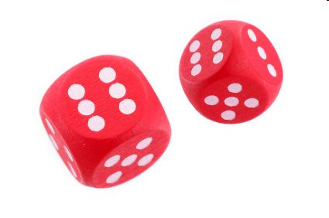
“Gods do play dice! “
Write a program to simulate the tossing of an unbiased dice.
If two dices were thrown and there top values were added, What is the probability of getting a sum of 7 ?

Slide 18
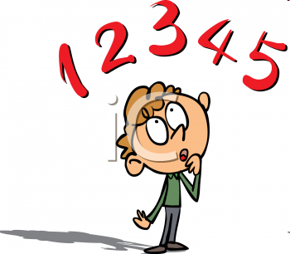
More about Rand
‘ rand’ function only generates values between 0 and 1.
What if I wanted a random value between … say…
25 and 30 ?

Slide 19
rand
-10
0
1
25
30
25 + rand
1
25
30
-10
0
25 + rand*(5)
1
25
30
-10
0

Slide 20
Finding the area of a circle
2×r
r
2×r

Slide 21
Finding the area of a circle
2×r
r
2×r

Slide 22
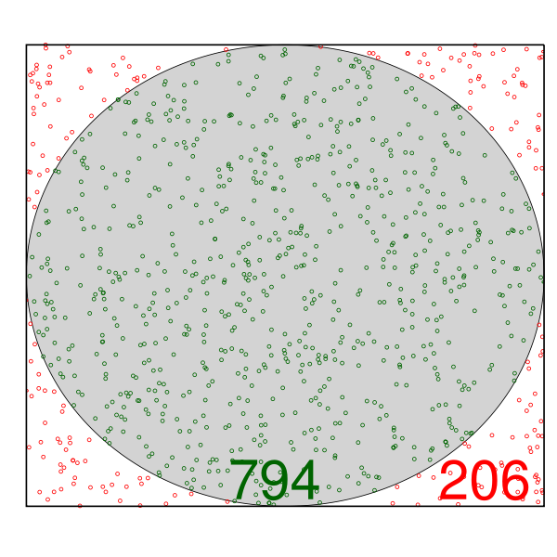
Finding the area of a circle

Slide 23

Calculation
If radius is 10 cm
Area of the square = 20×20 = 400 cm²
Lets assume all points were generated randomly. Then
Number of Hits is proportional to the hit area. Larger the area larger the num of hits.

Slide 24


Slide 25

Results!
Area of the circle with radius 10 is
According to the Monte Carlo calculation I got 317.6
Real area according to the geometry is 314.5

